Slide 1
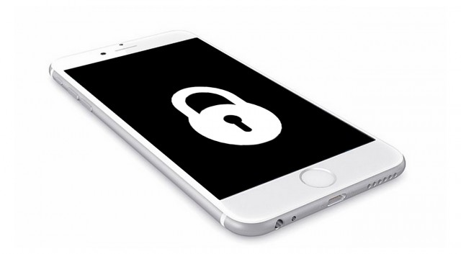
iOS Security
Rawan Khaled
Farah Essam
Nourhan Jamal

Slide 2

Agenda…
Introduction
System security
Network security
TLS
Bluetooth
AirDrop

Slide 3
Introduction
Apple designed the iOS platform with security at its core.
Every iOS device combines software, hardware , and services designed to work together for maximum security and a transparent user experience.
iOS protects not only the device and its data at rest, but the entire ecosystem, including everything users do locally, on networks, and with key internet services.

Slide 4
System Security
The integrated and secure software and hardware that are the platform for iPhone, iPad, and iPod touch
This includes the boot-up process, software updates, and Secure Enclave.
This architecture is central to security in iOS, and never gets in the way of device usability.

Slide 5
iOS software updates can be installed using iTunes or over the air (OTA) on the device. With iTunes, a full copy of iOS is downloaded and installed. OTA software updates download only the components required to complete an update,

Slide 6
BOOT ROM
Its a code that the application proceesor execute from read-only memeory when an iOS device is turned on.
Its known as the hardware root of trust.
It contains the Apple Root CA(certificate authority) public key, which is used to verify that the iBoot bootloaderis signed by Apple before allowing it to load
A failure of the Boot ROM to load LLB(low level bootloader (on older devices) or iBoot (on newer devices) results in the device entering DFU(device firmware upgrade) mode known, if it failed to verify the exit step the device enters the recovery mode.

Slide 7
System Software Authorization:
It’s a process iOS uses to prevent devices from being downgraded to older versions that lack the latest security update.
Secure Enclave:
It's a coprocessor that provides all cryptographic operations for data protection.
It utilizes System Software Authorization to ensure the integrity of its software and prevent downgrade installations.

Slide 8
Secure enclave:
Boot Progress Register (BPR) is used by the Secure Enclave to limit access to user data in different modes and is updated before entering the following modes:
• Recovery Mode: Set by iBoot on devices with Apple A10, S2, and newer system on chip (SoCs)
• DFU Mode: Set by Boot ROM on devices with an A12 SoC

Slide 9
Other Security Features that iOS provides:
FaceID: Automatically adapts to changes in your appearance, and carefully safeguards the privacy and security of your biometric data.
TouchID: Technology reads fingerprint data from any angle and learns more about a user’s fingerprint over time
Passcode: You must set up your device so that a passcode is required to unlock it and to use the faceUD and touchID.

Slide 10
Situations that passcode is required:
Updating your software.
Erasing your device.
Viewing or changing passcode settings.
Installing iOS configuration profiles.
The device has just been turned on or restarted.
The device hasn’t been unlocked for more than 48 hours

Slide 11
Network security
Industry-standard networking protocols that provide secure authentication and encryption of data in transmission.
iOS integrates proven technologies and the latest standards for both Wi-Fi and cellular data network connections.

Slide 12
1. TLS
iOS supports Transport Layer Security (TLS v1.0, TLS v1.1, TLS v1.2) and DTLS.
It prefers cipher suites with perfect forward secrecy.
Why do we need it ?
Encryption
Authentication
Goals/Result :
Trusted end- to-end communications

Slide 13

2. Bluetooth
Bluetooth support in iOS has been designed to provide useful functionality without unnecessary increased access to private data.
iOS supports the following Bluetooth profiles:
Hands-Free Profile (HFP)
Phone Book Access Profile (PBAP)

Slide 14
2. Bluetooth
Hands-Free Profile (HFP 1.6)
Hands-Free Profile allows Bluetooth headsets and car hands-free kits to communicate with mobile phones.
Phone Book Access Profile (PBAP)
Phone Book Access Profile allows the exchange of Phone Book Objects between iPhone and other Bluetooth devices
A car kit and a mobile phone use the profile to:
Allow the car kit to display the name of the incoming caller.
Allow the car kit to sync the phone book so the user can make a call from the car display.

Slide 15
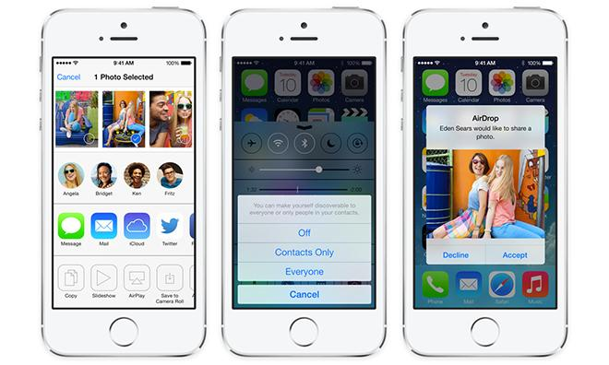
3. AirDrop Security
iOS devices that support AirDrop use Bluetooth Low Energy (BLE) and Apple created peer-to-peer Wi-Fi technology to send file and information to nearby devices.

Slide 16
Internet Services
Apple ID
It is the account that is used to sign in to Apple services such as iCloud, iMessage, FaceTime and more.
Strong password
Security questions
Sends email and push notifications to users when important changes are made to their account
Employs a variety of policies and procedures designed to protect user accounts.
Limiting the number of retries for sign-in and password reset attempts
Active fraud monitoring to help identify attacks as they occur
Regular policy reviews that allow Apple to adapt to any new information that could affect customer security.

Slide 17
Two-factor authentication
An extra layer of security for Apple IDs.
It is designed to ensure that only the account’s owner can access the account, even if someone else knows the password
To sign in for the first time on any new device, Apple ID password and a six digit verification.
Two-step verification
The user’s identity must be verified via a temporary code sent to one of the user’s trusted devices before
Changes are permitted to their Apple ID account information.
Managed Apple IDs
Owned and controlled by an educational institution.

Slide 18
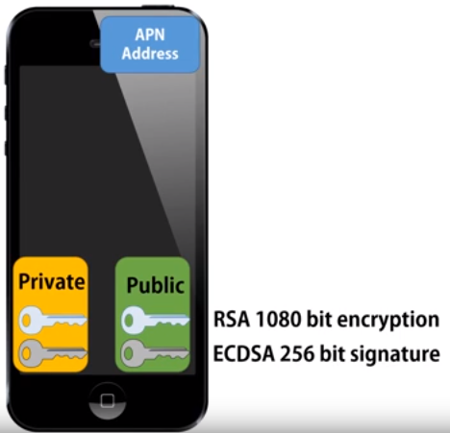
iMessage
iMessage makes extensive use of the Apple Push Notification service (APNs)
Notes:
Every user has apple push notifications , which means that apple push messages to your phone , ipad , macbook pro
Setup imessage -> creates RSA 1080 Encryption key - private -> can ony decrypted message
Public ->encrypt the msg
If the sender has your public -> mmkn yb3tlk msg , wenta tstkhdem l private tfta7 l msg
256 -> sign the message with ur private key -> w y3rfo enk enta ely 3mlt sign bel public key
Function only works one way

Slide 19
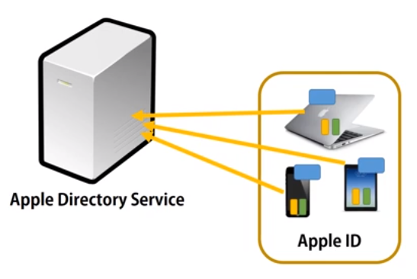
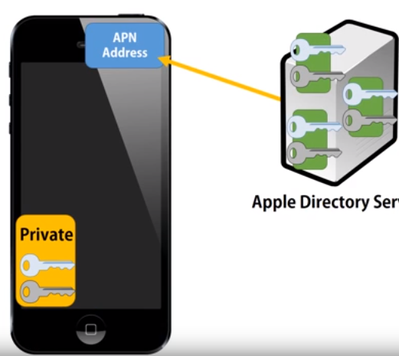
Apple directory service stores all of the public keys associated with the apple devices using iMessages and communicate with the APN’s private key’s.
Notes:
Apple directory service -> keeps all your key’s
Devices on the right -> unique APN -> unique private w public key , however they all have the same apple id -> belongs to the same person

Slide 20
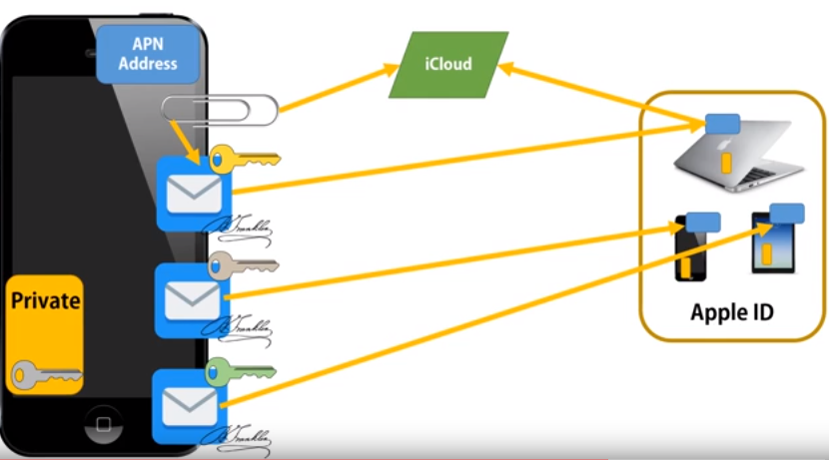
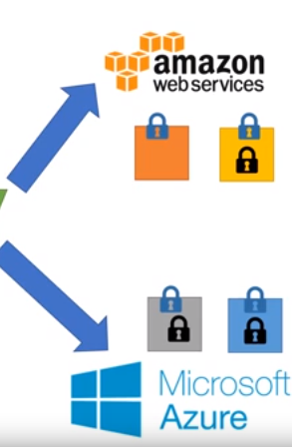
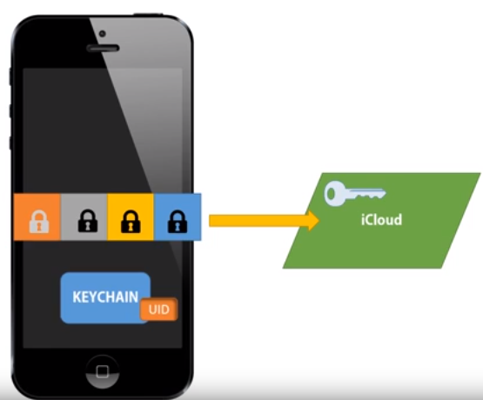
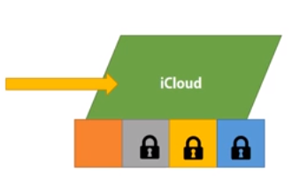
If there’s more than one device uses the iMessage
Data on your phone stored on different classes which gets back to iCloud
The iCloud generates key in order to copy data securely
Notes:
Create 3 copies of the message and sign each message with our private key
Encrypt each message with the recipients public key , w kol msg bttb3t ll APN of each device
User can use his private key to decrypt them
If there’s an attachments -> uploaded to the icloud
-----------
Data on ur phone stored on different classes which gets back to iCloud
------------
- it doesn’t sore the data on apple servers , it stores it on rented servers -> amazon , microsoft. -> in order to keep them from seeing ur data -> all data are broken up and encrypted to chunks

Slide 21
FaceTime
FaceTime is Apple’s video and audio calling service. Similar to iMessage, FaceTime calls also use the Apple Push Notification service to establish an initial connection to the user’s registered devices.
Establish connection
Apple server infrastructure that relays data packets between the users’ registered devices.
Using APNs notifications and Session Traversal Utilities for NAT (STUN) messages over the relayed connection, the devices verify their identity certificates and establish a shared secret for each session.

Slide 22


